Slide 1
Sketch Recognition:
Truth Table Domain
Sara Sheehan
Sketchers 2007

Slide 2
Motivation
Truth tables are used to describe logic gates, which are used in digital circuit diagrams.
Circuit diagrams are used by our engineering students to describe hardware functionality.
Our goal is to build software that will help students learn through circuit and truth table recognition and error correction.

Slide 3
Related Work
Many domains have been explored in the field of sketch recognition and understanding.
Includes digital and analog circuits, family trees, math and physics diagrams, text.
As far as I know, truth tables have not been explored as much as other domains, but it is a more simplistic problem.

Slide 4
Approach
Stroke based approach, not image based.
Horizontal and vertical dividers are grouped and recognized separately based on distance, curvature, and angle metrics.
Used to separate labels from the pin data, and input data from output data.
Determining the number of columns is an important and challenging next step. My first step is to find divisors of the number of data pieces.

Slide 5
Approach (cont.)
These possible column numbers are then tested to see which produces the smallest sum of the slopes of the rows.
After the number of columns has been determined, the 1,0,X data are filed into a matrix using they Cartesian coordinates.
The data pieces with the lowest y-coordinates are then filed into the first row, provided that x-coordinate constraints are not violated.

Slide 6
Approach (cont.)
After the matrix has been created, labels strokes are grouped based on their proximity to the first data piece in each row. (several label grouping methods were used, including k-means, but this seems to work the best)
Labels are then recognized using Microsoft text recognition with a word list that users can edit and modify.

Slide 7
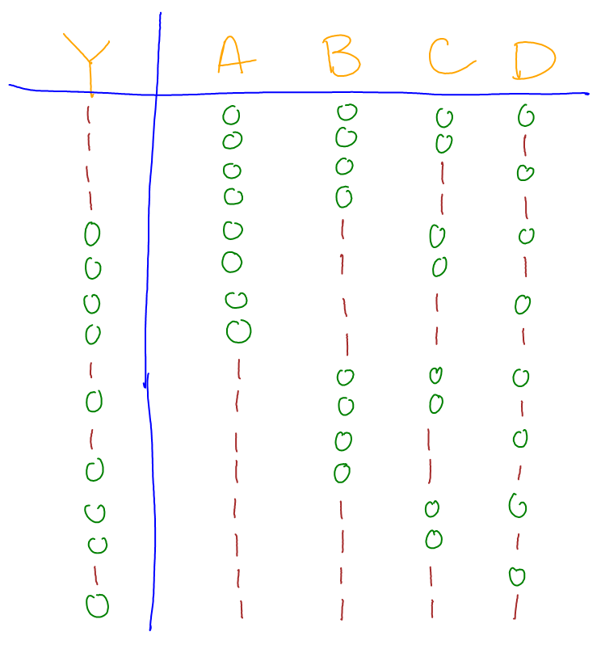
Truth Table 1
Recognition Result
Y_ AB CD
1 _ 0 0 0 0
1 _ 0 0 0 1
1 _ 0 0 1 0
1 _ 0 0 1 1
0 _ 0 1 0 0
0 _ 0 1 0 1
0 _ 0 1 1 0
0 _ 0 1 1 1
1 _ 1 0 0 0
0 _ 1 0 0 1
1 _ 1 0 1 0
0 _ 1 0 1 1
0 _ 1 1 0 0
0 _ 1 1 0 1
1 _ 1 1 1 0
0 _ 1 1 1 1

Slide 8
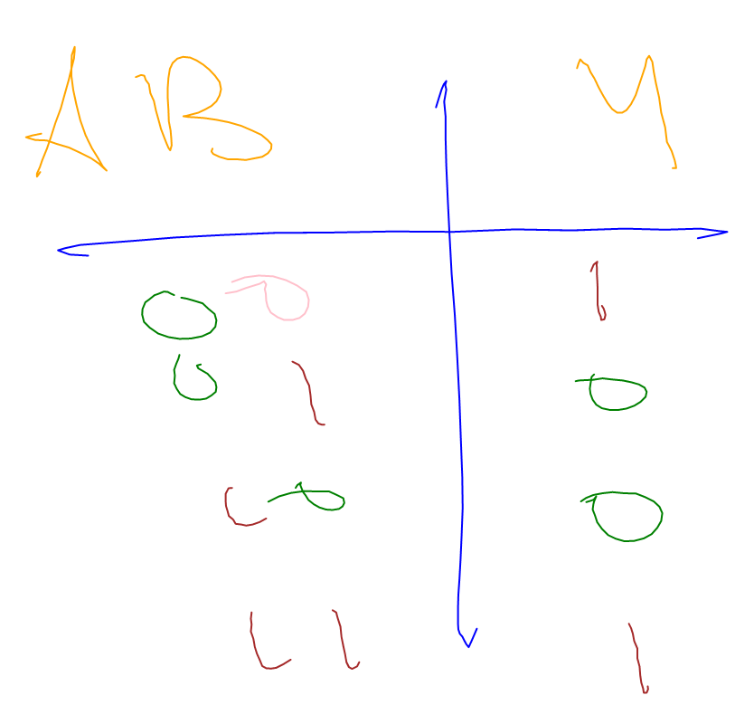
Truth Table 2
Recognition Result
AB _ N
0 X _ 1
0 1 _ 0
1 0 _ 0
1 1 _ 1
* Microsoft text recognition incorrectly
classified a 0 as an X, and the Y as an N

Slide 9
Results
Program was tested on 97 truth tables, and ignoring text recognition errors, 90 were correctly identified.
4 errors were due to incorrect label grouping (two labels drawn above the same column)
1 error in the number of columns
1 error due to two zeros overlapping
1 error due to a split horizontal divider
Overall: 93% accuracy (ignoring text recognition)

Slide 10
Improvements/Future Work
Guessing the number of columns still drastically affects the run time for larger truth tables, so one area of future work might be to improve how the number of columns is determined.
Label grouping is the biggest problem with recognition. Label strokes are scattered, hard to predict, and user specific, which is why the entire sketch is grouped and recognized independently of the labels.

Slide 11
Conclusion
Accurate truth table recognition can provide feedback for digital circuit recognition, as well as aid the user in error correction and learning.
The truth table domain, while more restricted and straight forward, provides some interesting challenges in the field of sketch recognition.

